Slide 1
Cloud
Notes:
Lets talk about cloud.

Slide 2

Cloud
Private vs. public cloud
Marketing buzzword
Services
Notes:
Here, we mainly talk about public cloud, not private. Public cloud means, everyone can access a service but there is no connection to the local network of the customer.
It‘s difficult to talk about „cloud“ because this term is mainly used for marketing. So, everything new and shiny is „cloud“.
We better talk about services.

Slide 3
Cloud
Infrastructure as a Service
Managed hardware
Highly configurable environment
Software as a Service
Platform as a Service
Complete managed stack
Managed OS, Frameworks, …
"Deploy and Run"
Completely under control of provider
Private vs. public cloud
Marketing buzzword
Services
Level of management
Notes:
There are 3 types of services which we can order by the level of management that‘s provided.
„Infrastrucutre as a Service“ is similar to classical server hosting. But we do not only get servers and IP addresses but can define complete environments with subnets, load balancers, security rules and much more.

Slide 4
Cloud
Infrastructure as a Service
Managed hardware
Highly configurable environment
Software as a Service
Platform as a Service
Complete managed stack
Managed OS, Frameworks, …
"Deploy and Run"
Completely under control of provider
Private vs. public cloud
Marketing buzzword
Services
Level of management
Notes:
If we just want to run a cloud application we can use „Platform as a Service“.
We get an environment where we can just upload our code and start the apllication. The provider is responsible for maintaining this environment. For example to keep the operation system up to date.

Slide 5
Cloud
Infrastructure as a Service
Managed hardware
Highly configurable environment
Software as a Service
Platform as a Service
Complete managed stack
Managed OS, Frameworks, …
"Deploy and Run"
Completely under control of provider
Private vs. public cloud
Marketing buzzword
Services
Level of management
Notes:
Our goal ist to provide PLOSSYS 5 as „Software as a Service“
We are responsible for everything. Our customers only need to create an account, install a proxy in their local network and configure the printers. That‘s all.
On the other hand, we have complete control over all components. So we can make our lives easier – for example – by using Linux even if our customers stick with Windows only.

Slide 6
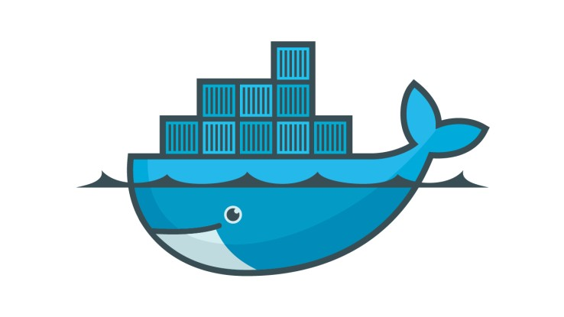
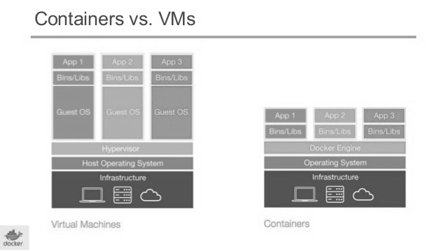
PLOSSYS 5: Cloud Native
VM
Docker Container
Slow: Hypervisor simulates hardware
Big: VM contains its own OS
Inflexible: Fixed resource allocation (RAM, CPU)
Isolation of processes
Shared access to OS
Resource-sharing possible
Notes:
Now, I want to show why PLOSSYS 5 is well prepared to be a cloud application.
First, we do not need to run on VMs but we can use Docker Containers.
Let‘s have a look at VMs:
VMs are slow because the hardware must be simulated
They are also big becaus we must install a complete operaton system in each VM
And they are not very flexible because we must allocate memory and CPU cores before we start a VM.
Docker containers are much more light-weight:
We use containers to isolate processes. So, they cannot affect or even see each other.
But all processes use the same operating system
This allows us to share all resources accross all containers. If one container is ideling, the others can use the free resources to do their work.
I think, the pictures show the differences quite nicely.
On the left there is a server running 3 VMs.
The gray area is the host.
The colored blocks are the VMs.
As you can see, the biggest part of a VM is the operating system.
On the right side, we see the same applications running in Docker containers
They are much smaller, because they only contain the files needed by the applications.
They are also very efficient. There is not a big difference between running an application on the host or in a Docker container.

Slide 7




PLOSSYS 5: Cloud Native
Containers instead of VMs
Microservices
Kubernetes, Openshift, Docker EE
Built-in monitoring
Load dependant scaling
Rolling updates
Notes:
So, we use constainers instead of VMs.
To take advantage of it, we have split PLOSSYS into small processes. They are called Microservices. Each microservice is responsible for only one task. For exapmle for receiving data from clients or for stamping a document.
To run an application in production, we must spread our microservice accross multiple servers. So the application can still work if a server crashes. We can use a container platform for this. There is Kubernetes, Openshift and Docker Enterprise Edition. In fact there is only Kubernetes, because Openshift and Docker Enterprise Edition just provide a nicer user interface for Kubernetes.
Kubernetes provides some nice features. For example monitoring: We get nofications if a container crashes and it also can be restarted automatically.
We can also automatically scale up the number of containers, if for example we get a batch of many print jobs. After processing all the jobs, all no longer needed containers are removed again.
We can even update our application while it‘s running. There are always enough services running to handle incoming print jobs.

Slide 8
PLOSSYS 5: IPPS
TLS encryption
IPP Shared Infrastructure Extensions
Notes:
Communication is also an important building block for our application. We decided to use Internet Printing Protocol wherever possible.
It‘s based on HTTP, so we get all features of HTTP for free. For example TLS-encryption.
There is also an important addition to the IPP standard called „IPP Shared Infrastructure Extenstions“.
As you can see in the picture, it deals with processing print jobs in the public cloud.

Slide 9



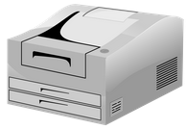

PLOSSYS 5: IPPS
PLOSSYS 5
Gateway
IPP Infra
Proxy
IPP Proxy
Notes:
Here we see basically the same picture.
We have PLOSSYS running as a public cloud service.
And there are some devices located in the local network of the customer. All are protected by a firewall.
There is no problem seinding data to our PLOSSYS since we just use HTTPS.
But PLOSSYS cannot reach the printers for two reasons:
First, they only have private ip addresses assigned to
Second, any incoming connection is blocked by the firewall
So we need a proxy inside the network which opens a connection to PLOSSYS.
Now, our gateway component can send a job to the proxy wich forwards it to the printer.
That‘s all defined by the IPP Extention. We have an IPP Proxy and an IPP Infrastructure Printer and all needed comminucation is defined by the standard.

Slide 10
PLOSSYS 5: IPPS
Feedback
Job status
Printer monitoring
Control of print jobs
Communication across multiple data centers
IPPS
IPPS
IPPS
PLOSSYS 5
PLOSSYS 5
Notes:
We can also use IPP to send feedback to the client. For example about the status of jobs or printers.
We can even control jobs via IPP. For example cancel or redirect jobs.
Communication is also possible accross multiple datacenters.

Slide 11
Where are we?
Notes:
That‘s my final slide. I want to say a few words about our current status.
Our goal is to provide PLOSSYS as Software as a Service.
The picture shows the start, not the finish line. I chose it because we are on the way, but there is still much work to do. For example we are currently implementing the IPP protocol but multi-datacenter communication is still in planning. So please do not expect to see everything I mentioned to be available tomorrow. It‘s a long run.

Slide 12
Demo
Kubernetes

Slide 13


Florian Seidenspinner florian.seidenspinner@sealsystems.de
Wir sind für Sie da!
Michael Scherer michael.scherer@sealsystems.de

